Slide 1
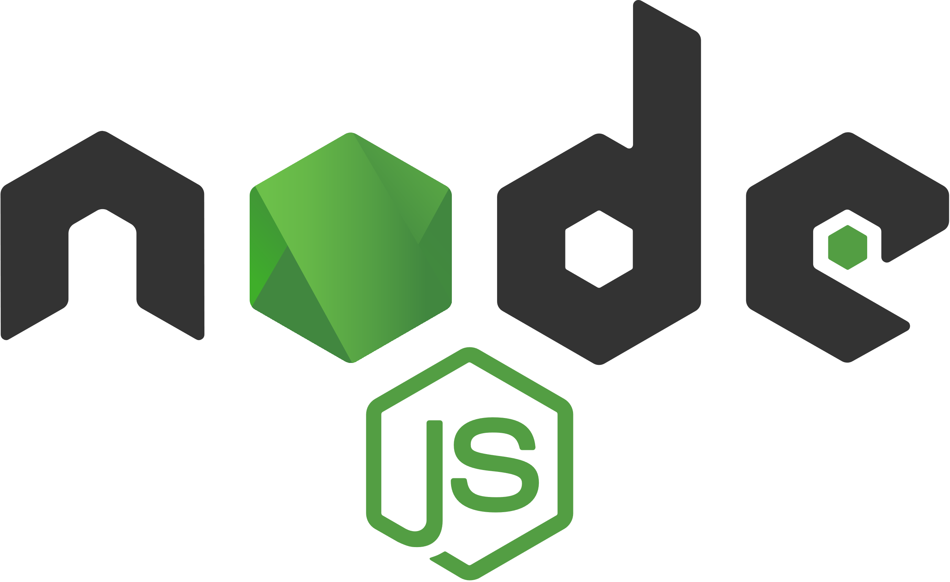
CPNT-262 Node.js

Slide 2
Course Information
Important information about this course. Please refer back to these slides as needed.

Slide 3
Grading
Task | Percentage of Overall Grade
Daily JavaScript Exercises | 15%
JavaScript Final Project | 35%
Daily Node.js Exercises | 15%
Node.js Final Project | 35%
Total Grade for CPNT-262 | 100%

Slide 4
Introduction to Node.js

Slide 5
What is Node.js?
Not a programming language
An environment that lets you use JavaScript outside of the browser
Uses Chrome’s V8 JavaScript engine
With Node.js, you can build anything from small command line tools to HTTP servers that power dynamic websites. Simply put, it’s server-side JavaScript.

Slide 6
Background
Reading and writing of data to and from the network and hard drive (input/output aka I/O) can be a difficult or slow task
JavaScript does not have a built-in way to do input and output (unlike Python, for example)
Moving data around takes time and scheduling it well makes your program faster

Slide 7
Node.js to the rescue
Designed to help you write JS programs that talk to networks, file systems or other I/O sources.
I/O sources like:
Databases
APIs
HTTP/WebSocket connections
Files

Slide 8
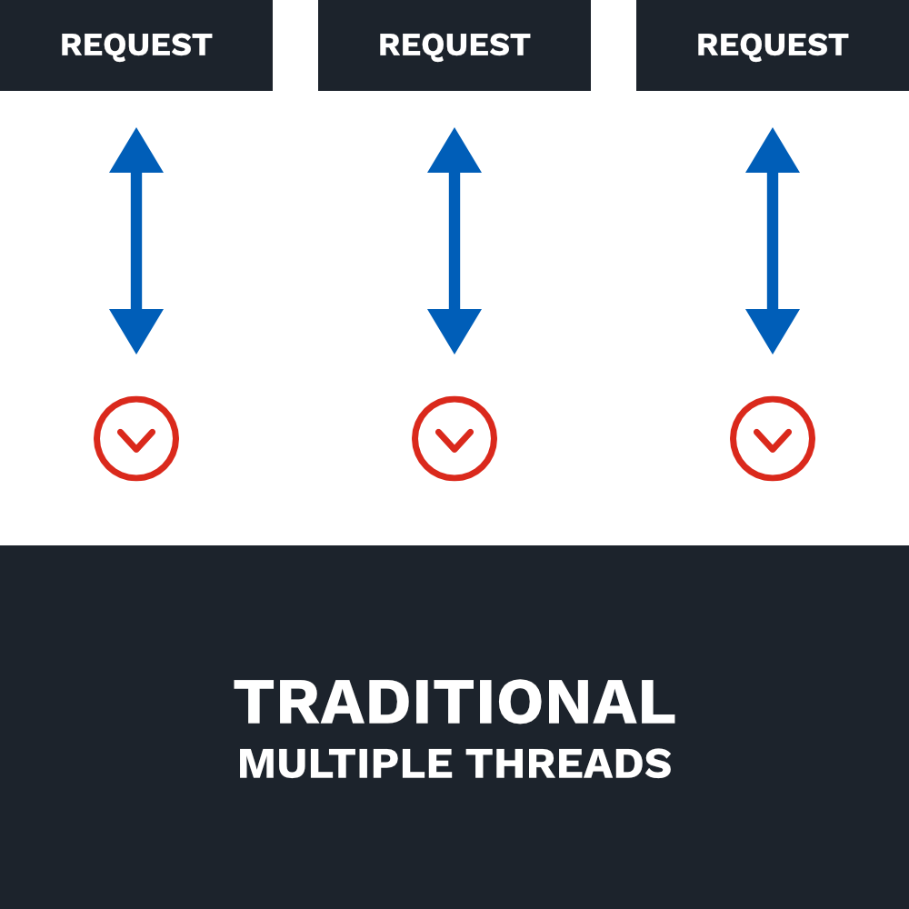
Traditional Web-Serving Techniques
Uses the thread model. 1 thread for each request.
In an I/O operation (downloading a file, for example), the request spends most of the time waiting for it to complete.
A lot of I/O operations can mean having a large amount of unused resources (like memory) linked to these threads.
1 thread per request (multiple threads) doesn’t scale well

Slide 9
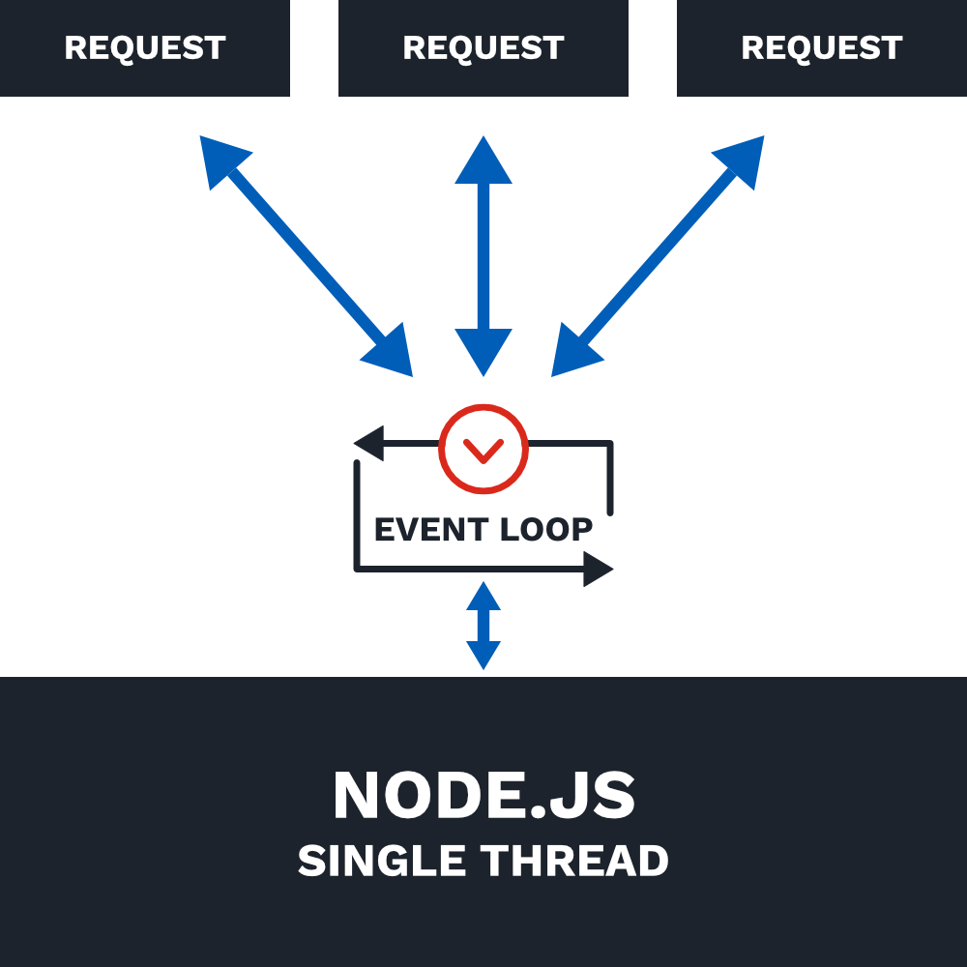
Node.js uses a single thread
Ryan Dahl, the creator of Node.js, argued that software should be able to multi-task and proposed eliminating time spent waiting for I/O results to come back.
Instead of the traditional thread model, Node uses a single thread.
and…

Slide 10
Node.js is... Asynchronous
Synchronous execution refers to code executing in sequence. The program is executed line by line, one line at a time. The program execution waits until a function returns before continuing to the next line of code.
Asynchronous execution refers to execution that doesn’t run in the sequence it appears in the code. The program doesn’t wait for the task to complete and can move on to the next task.
Remember using the Fetch API to fetch resources asynchronously? When the resource was ready, then we could do something with it.

Slide 11
Node.js is... Non-blocking
In a blocking I/O model, operations block other operations from happening while they wait for the operation to be finished.
In a non-blocking I/O model, operations don’t block other operations. If the program is waiting for something to happen, it can move on to another task instead of blocking all other tasks from happening. The program could come back and check again later or just do something later when it finally gets a response.

Slide 12
Node.js is... Event-driven
Node uses events heavily. Think of when you click on a button and a function is called. Or when a program is listening for a completed file download or an error.
In Node, there is a main event loop that listens for events and then triggers a callback function when one of those events is detected.

Slide 13
Node.js Example
Instead of writing code that goes through steps in order:
Read File
Print File Contents
Query Database
Filter Database Query Results
We break up tasks like this:
Read File and then Print File Contents
Query Database and then Filter Database Query Results

Slide 14
Node.js Example
Read File and then Print File Contents
Query Database and then Filter Database Query Results
Node will start at the top and begin reading the file, but reading a file takes some time. So while it’s reading the file and waiting on the results, Node can go to the next task and query the database.
If the program finishes reading the file first, then it will print the file contents. But if it finishes querying the database first, it will then filter the database query results.
Notes:
We don’t have to wait for each step in the program to finish before moving on to the next one. Similar to adding an event listener on a button click, but instead we’re listening for things like network requests and database queries.

Slide 15
Node.js Analogy – Fast Food
In a traditional model, you:
order your food
pay for your food
wait for your food, blocking all other customers from ordering
receive food and leave
In Node.js, you:
order your food
pay for your food
step over to the side and wait for your food. While you’re waiting, the cashier continues to take orders from other customers.
When your order is ready, the cashier lets you know. You receive your food and leave.
You need a lot more cashiers (threads) in the traditional model in order to handle all the customers!
Notes:
We don’t have to wait for each step in the program to finish before moving on to the next one. Similar to adding an event listener on a button click, but instead we’re listening for things like network requests and database queries.

Slide 16
History of Node.js
2009 – Designed by Ryan Dahl (and later sponsored by Joyent). Created out of a sense of frustration with Apache HTTP server’s ability to handle many concurrent connections and the common way of writing code where code blocked the entire process or multiple threads were needed
2010 – Introduced package manager; npm, created by Isaac Schlueter
2011 – Supported on Windows (instead of just Linux and Mac OS X)
2012 – Dahl stepped aside. Schlueter took over.
2014 – Timothy J. Fontaine took over.
2014 – A fork of Node.js (io.js, created by Fedor Indutny) created due to internal conflict over Joyent’s governance.
2015 – Node.js and io.js communities voted to work together under the Node.js Foundation. Node.js v0.12 and io.js v3.3 merged back together into Node v4.0. Yay ES6 features and more!
Current versions of Node.js are 10.16.3 LTS (long-term support) and 12.10.0 Current (latest features).

Slide 17
Set Up Node.js

Slide 18
Obligatory Hello World
Yeah, it’s overdone. But it’s traditional so let’s go for it anyway!

Slide 19
Prerequisites
Node.js and npm installed
Internet Access/Browser
Text Editor

Slide 20
Activity: Install Node.js
Download the Node.js installer (LTS version): https://nodejs.org/en/download/
Run the installer (default options are good).
Verify installation. Open a terminal and type in
node -v
If Node.js is installed correctly, it will display the version number.
Notes:
Check to make sure everyone has installed correctly and has a current version.

Slide 21
Activity: Hello World
Create a project folder on your Desktop named sait-node.
Open your text editor and create a new file named hello.js. Save it to your sait-node folder.
Inside your hello.js file, write the following code:
Save the file and run it by typing node hello.js in the terminal. (you’ll need to navigate to the correct folder first)
console.log("Hello World!");
Notes:
Check to make sure everyone has installed correctly and has a current version.

Slide 22
Built-in Node.js Modules

Slide 23
Modular Design
When creating an application, you often reach a point where putting all your code in a single file becomes unwieldy.
Node modules bundle up code for reuse, and they don’t alter the global scope.
Node modules allow you to select which functions and variables from the included file are exposed to your app.
You can use built-in Node modules, 3rd-party modules, or even build your own.
Notes:
Use modules to organize all related code into a single file. Modules can be small and can serve a very specific purpose.

Slide 24
Built-in Node Modules
Node.js has several built-in modules that you can use in your app.
HTTP module – make Node.js act as an HTTP server
File System module – Handle the file system
URL module – Parse URL strings
To see a list of built-in modules, you can run the following code:
const builtin = require("module").builtinModules;
console.log(builtin);

Slide 25
Creating a Web Server

Slide 26
Web Servers and HTTP Requests
Web browsers communicate with web servers using HyperTextTransfer Protocol (HTTP).
When you click a link on a page, submit a form, or run a search, the browser sends an HTTP Request to the server.
URL identifying the target server and resource
Method that defines the required action (get a file, update data, etc.)
Any additional information (search parameters, form data, etc.)

Slide 27
Web Servers and HTTP Response
Web servers wait for request messages, process them, and reply with an HTTP Response message
HTTP Response contains:
Status code (“200 OK”, “404 Not Found”, “403 Forbidden”)
A successful response to a GET request would also contain the requested resource
https://developer.mozilla.org/en-US/docs/Learn/Server-side/First_steps/Client-Server_overview

Slide 28
HTTP Module
In the previous activity, we Hello World shows up in the terminal. But wouldn’t it be nice if we could display it in our browser instead?
To make this happen, we need to build a web server!
The HTTP module will allow us to send requests and get responses.

Slide 29
Activity: HTTP Module
Create a new file named app.js. Save it to your sait-node folder.
Notes:
Go over to your editor and walk through how to create a web server.

Slide 30
Step 1: Load HTTP module
The HTTP module is a module in Node.js that provides useful functions and classes to build an HTTP server.
In order to tell our program that we’re going to use this module, we must “require” it.
// Load HTTP module
const http = require("http");
Notes:
https://nodejs.org/api/http.html

Slide 31
Step 2: Create the HTTP server
Next, we need to create the server and pass in a function that will handle the server configuration and what to do with the response
We will also listen on a port of our choosing for requests (port 8000)
// Load HTTP module
const http = require("http");
// Create HTTP server and listen on port 8000 for requests
http.createServer((request, response) => {
}).listen(8000);
Notes:
https://nodejs.org/api/http.html

Slide 32
Step 3: Set response HTTP header
Use response.writeHead() method to pass in the status code (200 means all is OK) and the response headers.
const http = require("http");
http.createServer((request, response) => {
// Set the response HTTP header with HTTP status and Content
response.writeHead(200, { "Content-Type": "text/html" });
}).listen(8000);
Notes:
If the response from the HTTP server is supposed to display as HTML, make sure to include an HTTP header with the correct content type.

Slide 33
Step 4: Send the response body
const http = require("http");
http.createServer((request, response) => {
response.writeHead(200, { "Content-Type": "text/html" });
// Send the response body "Hello World"
response.end("<h1>Hello World!</h1>");
}).listen(8000);
Notes:
After the page has been written, the response.end() method is called. The server should consider this message complete now.
We can also pass in data here. In this case, we passed in the text Hello World! wrapped in an h1 tag.
If we pass in data to response.end() it will assume it needs to response.write() that content before ending.

Slide 34
Step 4a: Send the response body
const http = require("http");
http.createServer((request, response) => {
response.writeHead(200, { "Content-Type": "text/html" });
// Use response.write() instead of response.end(). response.write("<h1>Hello World!</h1>");
response.end();
}).listen(8000);
Notes:
Alternatively, we can just use response.write() to write that content to the page. We still need to tell the server to end the response when we’re done.

Slide 35
Activity: HTTP Module
Save the file and run it by typing node app.js in the terminal.
In your browser, navigate to localhost:8000. You should see “Hello World!” on the page.
You can hit ctrl-C in your terminal to stop the server.

Slide 36
Step 5: Log a message when the server starts up.
const http = require("http");
http.createServer((request, response) => {
response.writeHead(200, { "Content-Type": "text/html" });
response.end("<h1>Hello World!</h1>");
// Pass in a function as the 2nd argument to listen() so that we log a message to the console when the server is running.
}).listen(8000, () => {
console.log(`Server running on port 8000`);
});
Notes:
You can also show them how to add a console.log message to show when the server is running. Just to make the experience a bit more obvious.

Slide 37
Read the Query String
const http = require("http");
http.createServer((request, response) => {
response.writeHead(200, { "Content-Type": "text/html" });
// Write the URL to the page
response.write(request.url);
response.end();
}).listen(8000);
The function we pass to http.createServer() has a request argument that represents the request from the client. This request object has a property called url that holds part of the URL.

Slide 38
Activity: Query String
Save the file again and run it by typing node app.js in the terminal.
In your browser, navigate to localhost:8000/sait. You should see “/sait” on the page.
Try navigating to other subfolders.
You can hit ctrl-C in your terminal to stop the server.

Slide 39
File System

Slide 40
File System Module
The Node.js file system module allows you to work with the file system on your computer.
With this module, we can:
Read files
Create files
Update files
Delete files
Rename files

Slide 41
Activity: FS Module
Import the FS module at the top of your app.js file.
const http = require("http");
// Load FS module at the top of the page. Just add it under previously loaded modules.
const fs = require("fs");

Slide 42
Activity: Read Files
Create a new file named demo.html.
Add some basic HTML code.
<!DOCTYPE html>
<html lang="en">
<head>
<title>Document</title>
</head>
<body>
<h1>Best Headline Ever</h1>
<p>What a great paragraph!</p>
</body>
</html>

Slide 43
Activity: Read Files
Back in app.js, let’s edit the createServer() code to read a file.
http.createServer((request, response) => {
fs.readFile("demo.html", (err, data) => {
response.writeHead(200, { "Content-Type": "text/html" });
// Write the data that we read from "demo.html".
response.write(data);
response.end();
});
}).listen(8000);

Slide 44
Creating and Updating Files
We can also create files using the FS module.
Several methods exist for creating new files:
fs.appendFile()
fs.open()
fs.writeFile()

Slide 45
Append Files
fs.appendFile() appends content to the end of a file.
If the file doesn’t exist, the file will be created.

Slide 46
Activity: Append File
Create a new file named file-system.js. In this file, add the following code and run it.
Try changing the content and running the file again.
const fs = require("fs");
fs.appendFile("newFile.txt", "Hello World! (again)", err => {
if (err) throw err;
console.log("File saved.");
});
https://nodejs.org/api/fs.html#fs_fs_writefile_file_data_options_callback

Slide 47
Open Files
fs.open() takes a “flag” as the 2nd argument.
Flags tell what mode to open the file as:
‘a’ – Open for appending. File is created if it doesn’t exist.
‘r’ – Opens file for reading. Exception occurs if file doesn’t exist. You can’t write to this file.
‘w’ – Opens file for writing. File is created if it doesn’t exist. If it does exist, you write over whatever was already in the file.
There are a ton more flags that you can use! https://nodejs.org/api/fs.html#fs_file_system_flags

Slide 48
Activity: Open File
Let’s create a new, empty file using the fs.open() method.
In file-system.js, add the following code:
fs.open('newFile2.txt', 'w', (err, file) => {
if (err) throw err;
console.log('File saved.');
});
https://nodejs.org/api/fs.html#fs_fs_open_path_flags_mode_callback

Slide 49
Write to Files
fs.writeFile() replaces the chosen file and content if it exists.
If the file does not exist, creates a new file containing the chosen content.

Slide 50
Activity: writeFile()
Let’s create a new file using the fs.writeFile() method.
In file-system.js, add the following code:
Try changing the content and running the code again. What happens to the file?
fs.writeFile("newfile3.txt", "Hello world!", err => {
if (err) throw err;
console.log("File saved.");
});
https://nodejs.org/api/fs.html#fs_fs_open_path_flags_mode_callback

Slide 51
Updating Files
We can also update files using the FS module (which we did in the last few activities).
Remember!
fs.appendFile() – Adds to the end of the file.
fs.writeFile() – Replaces the content in the file.

Slide 52
Deleting Files
We can also delete files using the FS module.
fs.unlink() – Deletes a specified file.

Slide 53
Activity: unlink()
Let’s delete a file using the fs.unlink() method.
In file-system.js, add the following code:
Check your folder. Where did newfile2.txt go?
fs.unlink("newfile2.txt", err => {
if (err) throw err;
console.log("File deleted.");
});
https://nodejs.org/api/fs.html#fs_fs_unlink_path_callback

Slide 54
Renaming Files
We can rename files using the FS module.
fs.rename() – Renames a specified file.

Slide 55
Activity: rename()
Let’s delete a file using the fs.rename() method.
In file-system.js, add the following code:
Check your folder. Where did newfile.txt go?
fs.rename("newfile.txt", "renamedFile.txt", err => {
if (err) throw err;
console.log("File renamed.");
});
https://nodejs.org/api/fs.html#fs_fs_rename_oldpath_newpath_callback

Slide 56
Parsing URLs

Slide 57
URL Module
The Node.js URL module splits up a web address into readable parts.
We can use url.parse() to return each part of the web address as separate properties.

Slide 58
Activity: URL Module
Go back to app.js and add (then run) the following code:
const url = require("url");
let address = "http://localhost:8000/demo.html?year=2019&month=october";
let parsedAddress = url.parse(address, true);
console.log(parsedAddress);
Notes:
Import the URL module
Save a URL with query strings to variable address.
Use url.parse() to parse the address and save this information to variable parsedAddress.
console.log(parsedAddress) to see what information you get back

Slide 59
Activity: URL Module
Log out the following:
host
search
pathname
year
month
Notes:
console.log(parsedAddress.host)
console.log(parsedAddress.search)
console.log(parsedAddress.pathname)
console.log(parsedAddress.query.year)
console.log(parsedAddress.query.month)

Slide 60
URL Module + Web Server
Now that we can parse query strings, let’s add some code to our web server.
We’re going to serve specific files requested by the client.

Slide 61
URL Module + Web Server: The Code
const http = require("http");
const fs = require("fs");
const url = require("url");
// Create HTTP server and listen on port 8000 for requests
http.createServer((request, response) => {
let parsedAddress = url.parse(request.url, true);
let file = "." + parsedAddress.pathname;
fs.readFile(file, (err, data) => {
response.writeHead(200, { "Content-Type": "text/html" });
response.write(data);
return response.end();
});
}).listen(8000);
Notes:
Demo transforming the previous code into this code.
Replacing “demo.html” with file variable. Parsing the address to create the file variable.
Return response.end() to exit the function (this will come in handy later when we handle errors)

Slide 62
Activity: Serve Specific Files
Create 2 new HTML files (similar to demo.html).
about.html – Put some content about you in this file.
contact.html – Add some information about how people can contact you here (just your email address is fine).
Modify your app.js createServer() code to serve specific files.
Visit localhost:8000/about.html and localhost:8000/contact.html.
Try visiting localhost:8000 and check your terminal for an error.

Slide 63
404 Page
If the filename doesn’t exist, then we can’t serve it!
Let’s write some code to handle what happens when there’s an error.

Slide 64
Activity: 404 Page
Add the following code to your createServer() code.
Visit pages that don’t exist. What happens?
if (err) {
response.writeHead(404, { "Content-Type": "text/html" });
response.write("<h1>404: Page Not Found</h1>");
return response.end();
}
Notes:
Returning response.end() is important or else we’ll continue trying to serve the particular filename that doesn’t exist.

Slide 65
Activity: Homepage
Can you think of a way to add a homepage to your code? Try to make it work!
Notes:
if (file === "./") {
file = "./homepage.html";
}
Students may come up with other ways of doing this. As long as it works, it’s fine. We’ll be using Express later.

Slide 66
Understanding Callbacks

Slide 67
Callbacks
Nearly everything in Node uses callbacks. You’ve seen them before as they are part of the JavaScript language.
Callbacks are functions that are executed asynchronously, or at a later time.
Notes:
https://stackoverflow.com/a/28757703

Slide 68
Callbacks Example
const fs = require("fs");
let file = fs.readFile("number.txt", "utf8");
console.log(file); // throws error because it runs before the file is read
Linear code isn’t how Node works. Here, readFile() will take a while to complete. Logging the file won’t work until it’s been read.

Slide 69
Callbacks Example
const fs = require("fs"); // fs is the built-in file system module
let file = fs.readFile("number.txt", "utf8", logFile);
function logFile(err, data) {
console.log(data);
}
We need to show that logging the file depends on readFile() finishing. That’s what callbacks are for. readFile() expects a function that is executed when it finishes reading the file. It expects a callback.
Notes:
Here, we’re creating a separate function named logfile(), but in previous examples, we just passed the entire function in rather than naming it.

Slide 70
Callbacks – Errors
const fs = require("fs");
let file = fs.readFile("number1.txt", "utf8", logFile);
function logFile(err, data) {
if (err) throw err;
console.log(data);
}
Most Node built-in modules use callbacks with 2 arguments: 1) the error (if one occurs) and 2) the results.
Notes:
You can check documentation to see what arguments a callback function requires.

